Slide 1
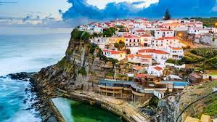
PORTUGAL
- Perfect place for summertime holidays

Slide 2
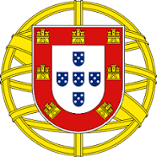
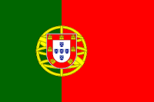
BASIC INFORMATIONS
Portugal is a country in a western part of Europe. Portugal borders with only one country - Spain. The capital city is Lisbon. The official language is Portugese. Marcelo Rebelo de Sousa is the president of Portugal.
EMBLEM OF PORTUGAL
FLAG OF PORTUGAL

Slide 3
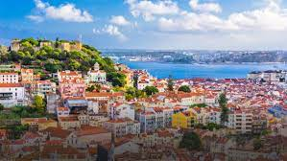
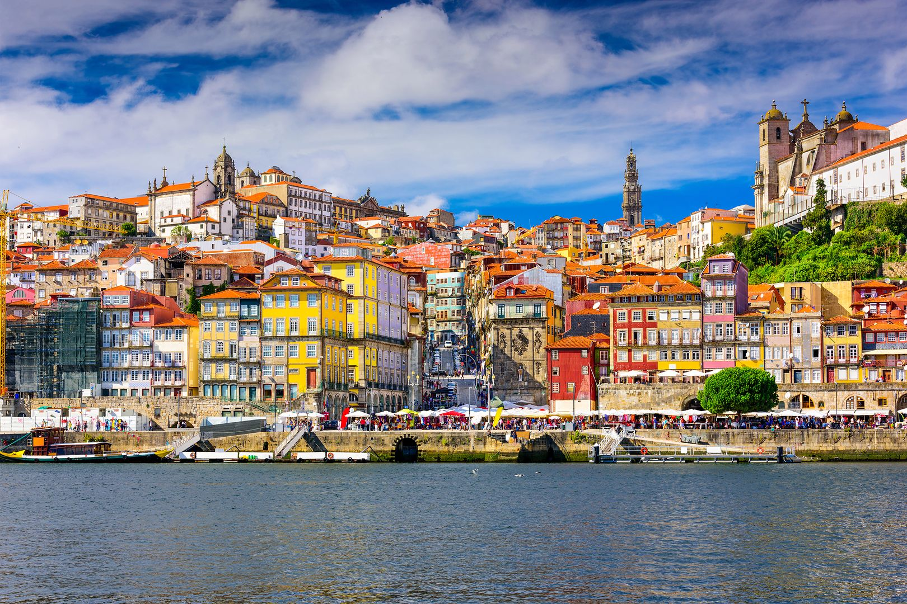
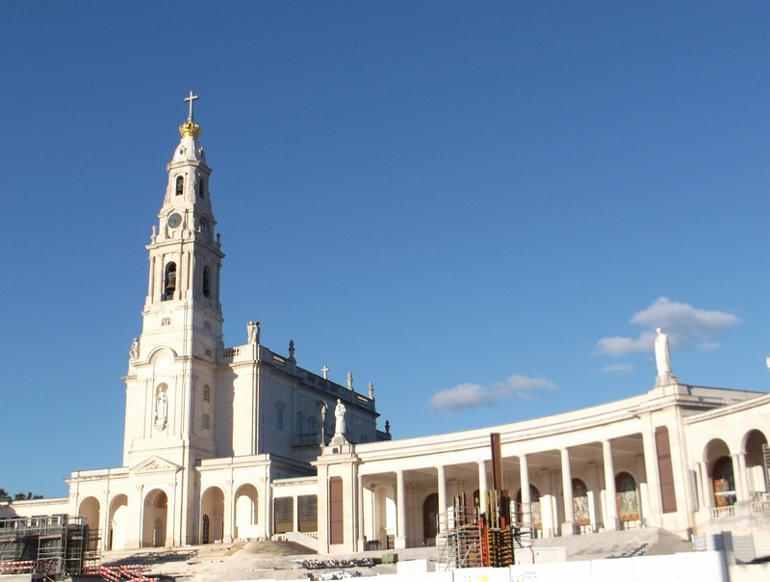
TOURISM
Portugal is a very popular travel direction. The most known places in Portugal is Lizbona – a capital, the biggest and one of the most beautifull city in this country and Porto.

Slide 4
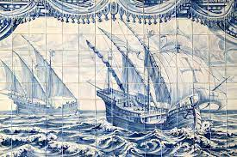
KULTURA
In Portugal culture there is a many references to the Roman culture Portual also has a strong connetion with history of Spain.
AZULEJOS

Slide 5
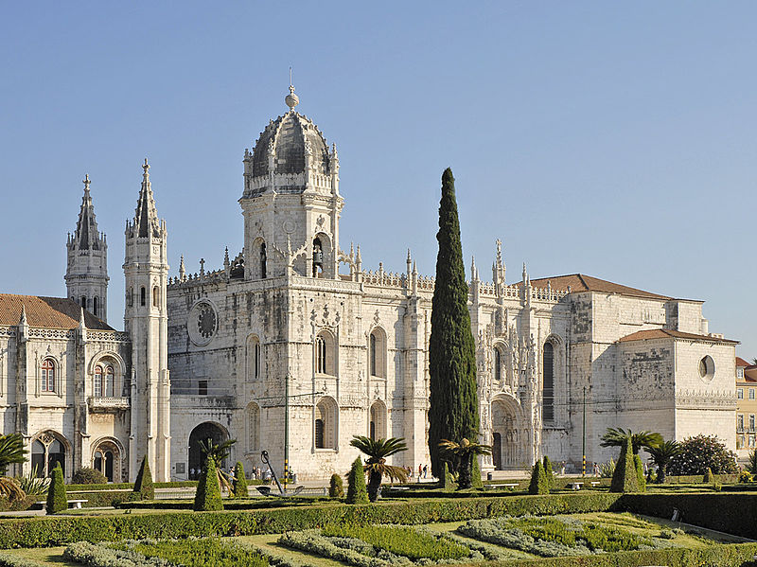
ARCHITECTURE
Charakterystyczny dla Portugalii jest styl manueliński, cechujący się ozdobną ornamentyką o motywach orientalnych i morskich (np. liny okrętowe, fale, koniki morskie czy koralowce). Styl ten powstał w okresie wielkich odkryć geograficznych, dokonywanych przez Portugalię, pod rządami króla Manuela I. Znakomitymi przykładami stylu manuelińskiego są: Klasztor Hieronimitów i Torre de Belém w Lizbonie oraz Klasztor Zakonu Chrystusa w Tomar.
Characteristic for Portugal is decorative ornamentation with oriental and sea motives. A great example of that style are: the Monastery of the Hieronymites and Torre de Belém in Lisbon and the Convent of the Order of Christ in Tomar.

Slide 6
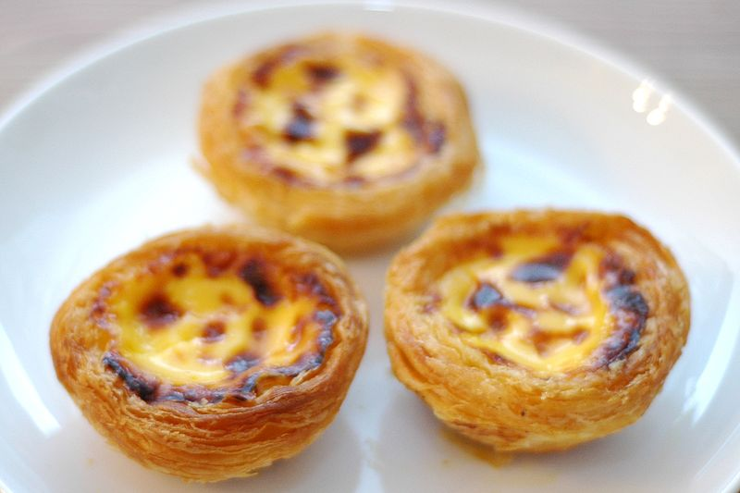
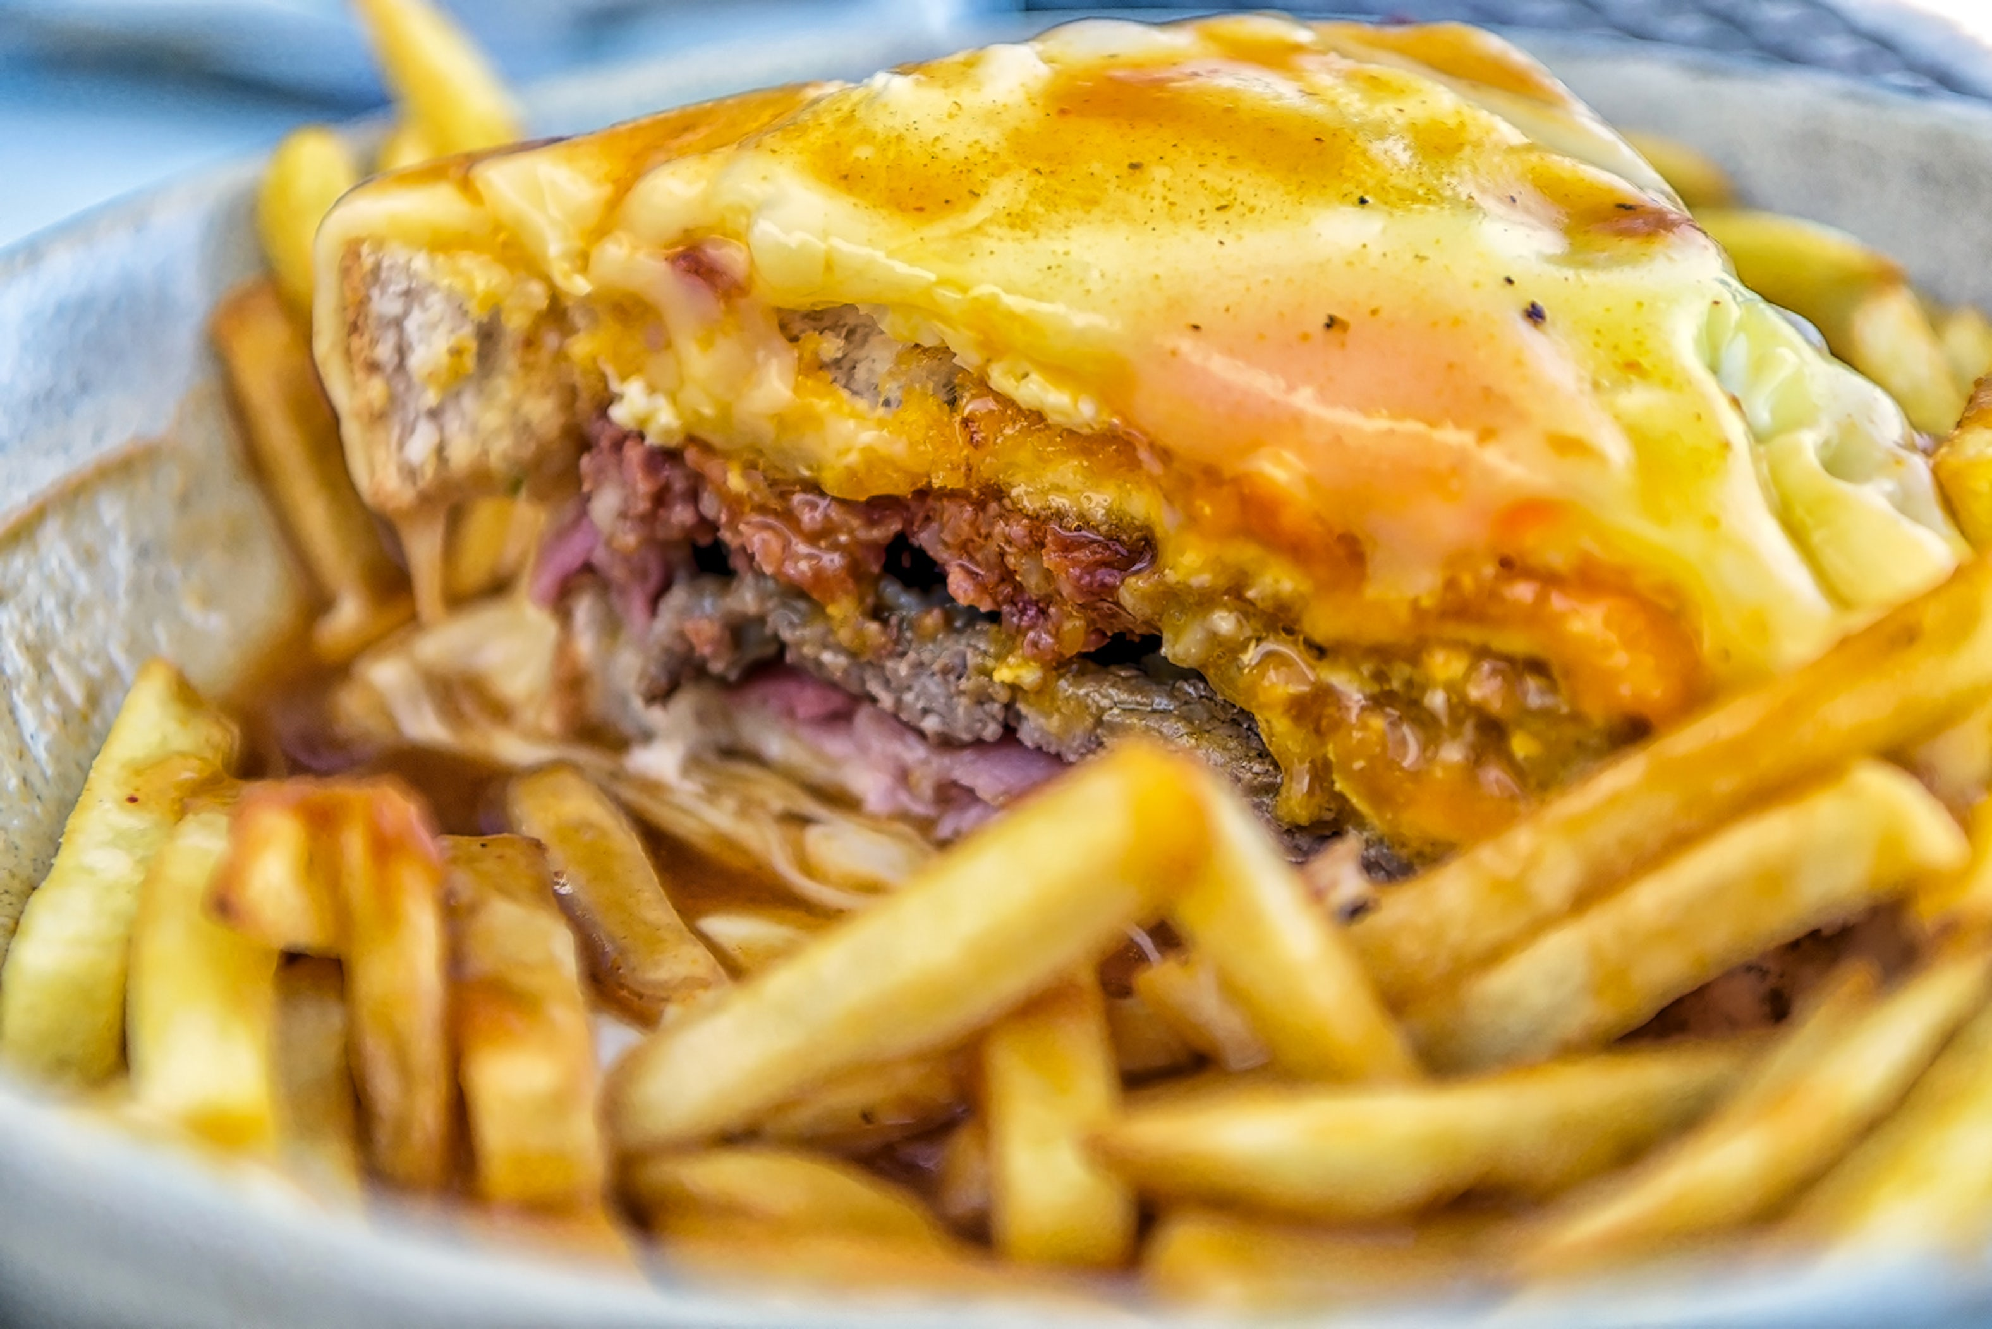
NATIONAL CUISINE
In Portugese cuisine is full of fishes and sea food that dominates in places close to the ocean. But in the centre part of the nation is dominated by meat and cheese. One of the most popular dish is: Francesinha,

Slide 7
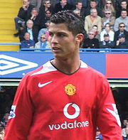
SPORT
Football is the most popular sport in the portugal. The biggest stars of portugise football are Cristiano Ronaldo and Luis Figo and trainers Jose Mourinho, Carlos Queiroz and Andre Villas-Boas.

